Slide 1



IOF Maintenance Ontology and practical uses for industry data
Presenter: Melinda Hodkiewicz
Workshop contributors: Caitlin Woods & Briana Davies-Morrell
IOF Annual Meeting - Arizona
February 2024
1

Slide 2
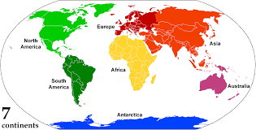
Introductions
Welcome
Introduce yourself and your interest/ experience in maintenance, reliability, asset management
Resources for this workshop (next slide)
Who are we?
Presenter: Professor Melinda Hodkiewicz
Workshop contributors: Caitlin Woods & Briana Davies-Morrell
iof-maint developers: Prof. Melinda Hodkiewicz, Caitlin Woods (both UWA), Dr. Matt Selway & Prof. Markus Stumpner (both UniSA)
University of WA
University of SA
Perth to Phoenix – 15,557 km (9,667 miles)
4

Slide 3
Workshop plan
PART 1 – Overview of the iof-maint development process and ontology
PART 2 – Use case based on the maintenance activity application ontology
PART 3 – Extracting information from unstructured maintenance texts and the role of ontologies in this process
4

Slide 4
Workshop Resources
PART 1:
GitHub - https://github.com/nlp-tlp/iof-maintenance-class
Maintenance Reference Ontology (IOF maintained site)
https://spec.industrialontologies.org/iof/ontology/maintenance/MaintenanceReferenceOntology/
OntoCommons site and FAIR assessment
https://industryportal.enit.fr/ontologies/IOF-MAINTENANCE
Iof-maint - Modular maintenance ontology (paper in submission to ESWC2024)
PART 2
Google colab site for maintenance activity ontology https://colab.research.google.com/drive/1gVgtC-JcXikNPzpp8p1wIGstF0EEnwBl
PART 3
Example application ontologies of iof-maint – see later slide
MaintIE: A Fine-Grained Annotation Schema and Benchmark for Information Extraction from Low-Quality Maintenance Short Texts https://github.com/nlp-tlp/maintie
4

Slide 5
Framing – why maintenance?
1

Slide 6
Value of maintenance data?
Maintenance is a huge spend
Annual Capability Sustainment cost for Aus. Defence 2021-22 A$13.6 billion (excluding cost of Defence personnel)¹
Companies like BHP spent US$3.5 billion a year on maintenance ²
The design, maintenance and operation of each asset generates a huge amount of sensor and text data over its life cycle
Unstructured text data about these assets is a significant resource
However, information extraction has been an issue (in the past)
https://ad-aspi.s3.ap-southeast-2.amazonaws.com/2022-06/Cost%20of%20Defence%202022-2023_v4.pdf
https://www.bhp.com/media-and-insights/prospects/2017/12/mining-data-to-improve-safety-and-cut-maintenance-costs//
4

Slide 7
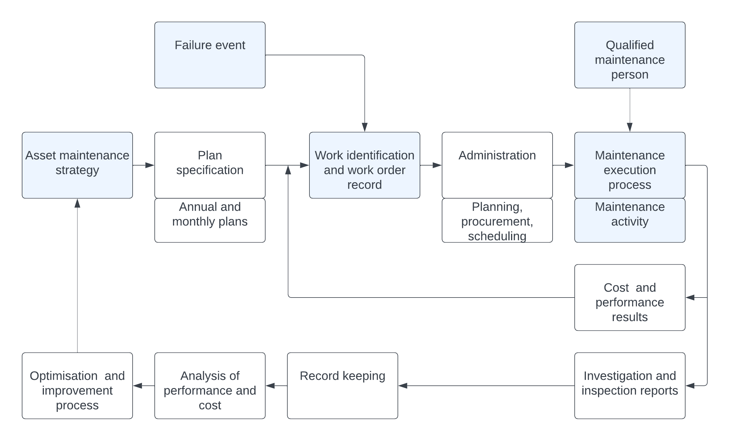
Maintenance management process
The maintenance management process, adapted from Coetzee and Karray, presented in ‘Iof-maint – Modular maintenance ontology’, Hodkiewicz, M, Woods, C. Selway, M, and Stumper, M., submitted to ESWC 2024.
4

Slide 8
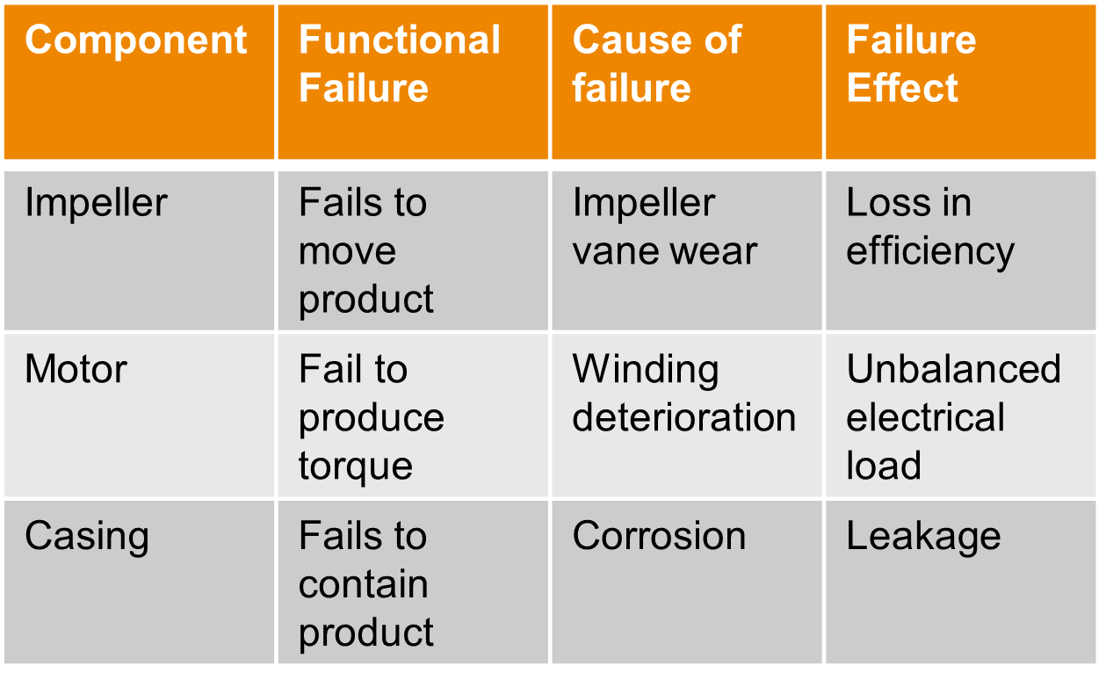
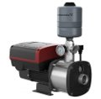
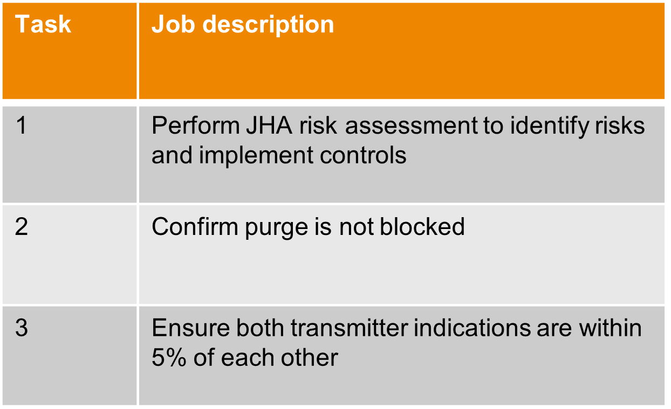
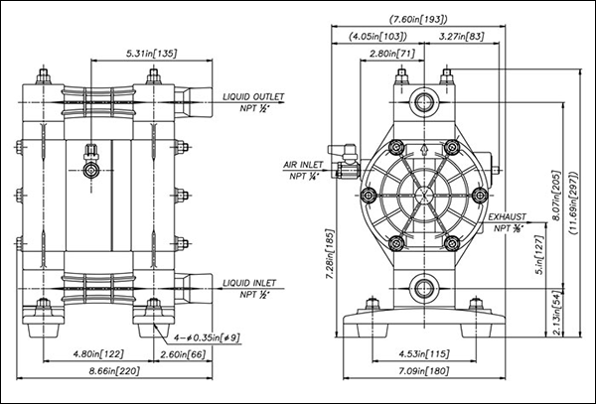
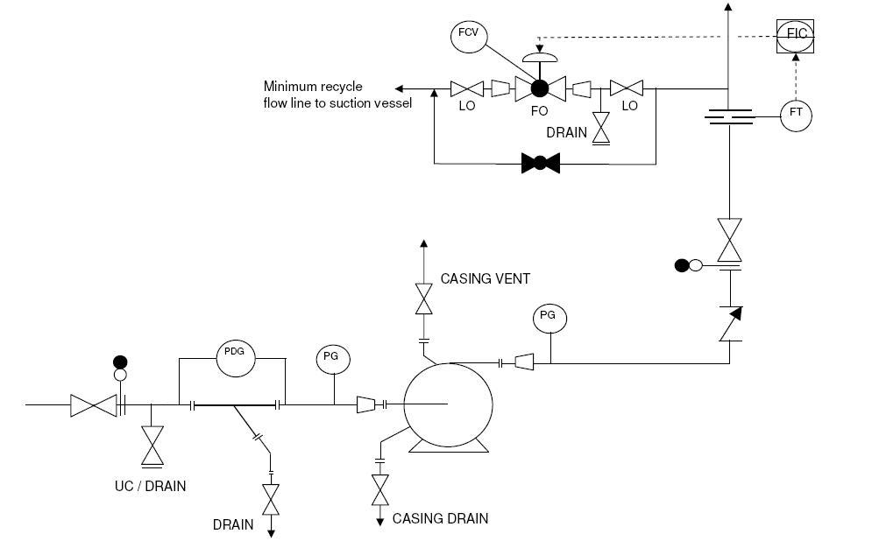
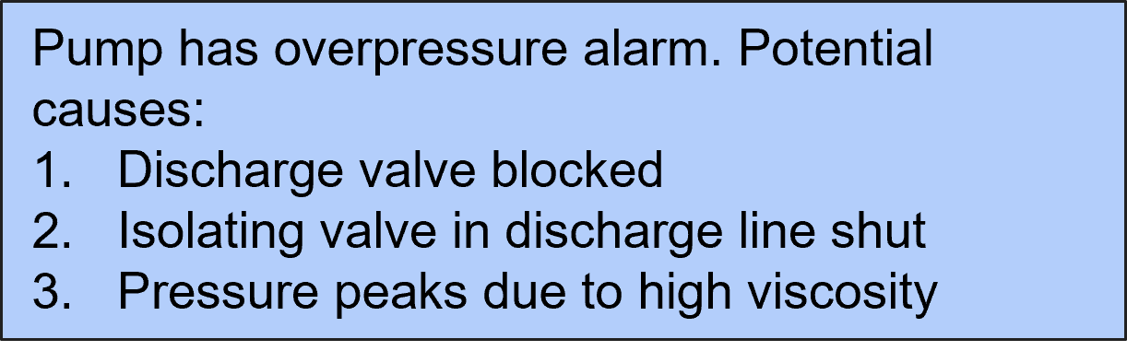
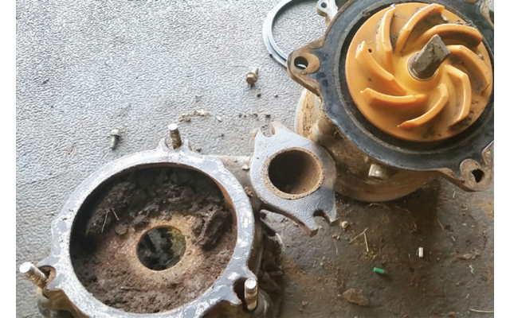
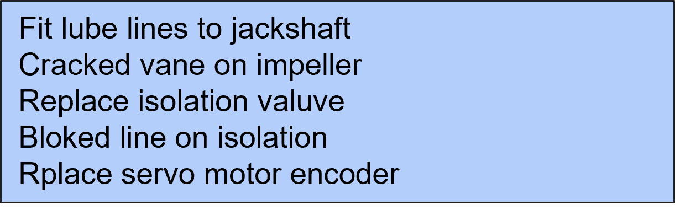
Examples of data generated in maintenance
FMEA - Asset reliability in design
Maintenance strategy & procedure development
Design
Build
Over 70% of data in organisations is unstructured text
Planned or corrective maintenance
Planned and corrective maintenance work captured in maintenance work order
Install & operate
Failure/ deterioration event investigation
Deloitte Report: Wisdom of Enterprise Knowledge Graphs
https://www2.deloitte.com/content/dam/Deloitte/de/Documents/operations/knowledge-graphs-pov.pdf
8
Notes:
Unstructured text is generated in the asset/ product information life cycle

Slide 9
Discussion?
What questions (and maintenance data) do you have for which an ontology is necessary?
Why is an ontology necessary and what do you mean by an ontology?
4

Slide 10

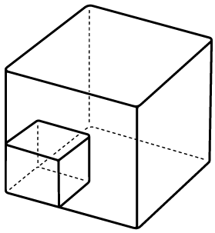


NLP + knowledge graphs + ontologies support
Fast
Scalable
Run pipeline across thousands of (maintenance) records rapidly
Process 1,000s of assets with 10,000s of records in minutes without significant SME resources
Reproducible
Standardised
Transparent pipeline construction and application with configurable parameterisation
Consistent adherence to Industry Standard(s) and able to integrate with Enterprise systems
15

Slide 11
Part 1
Overview of iof-maint
See GitHub
https://github.com/nlp-tlp/iof-maintenance-class/blob/main/README.md
1

Slide 12
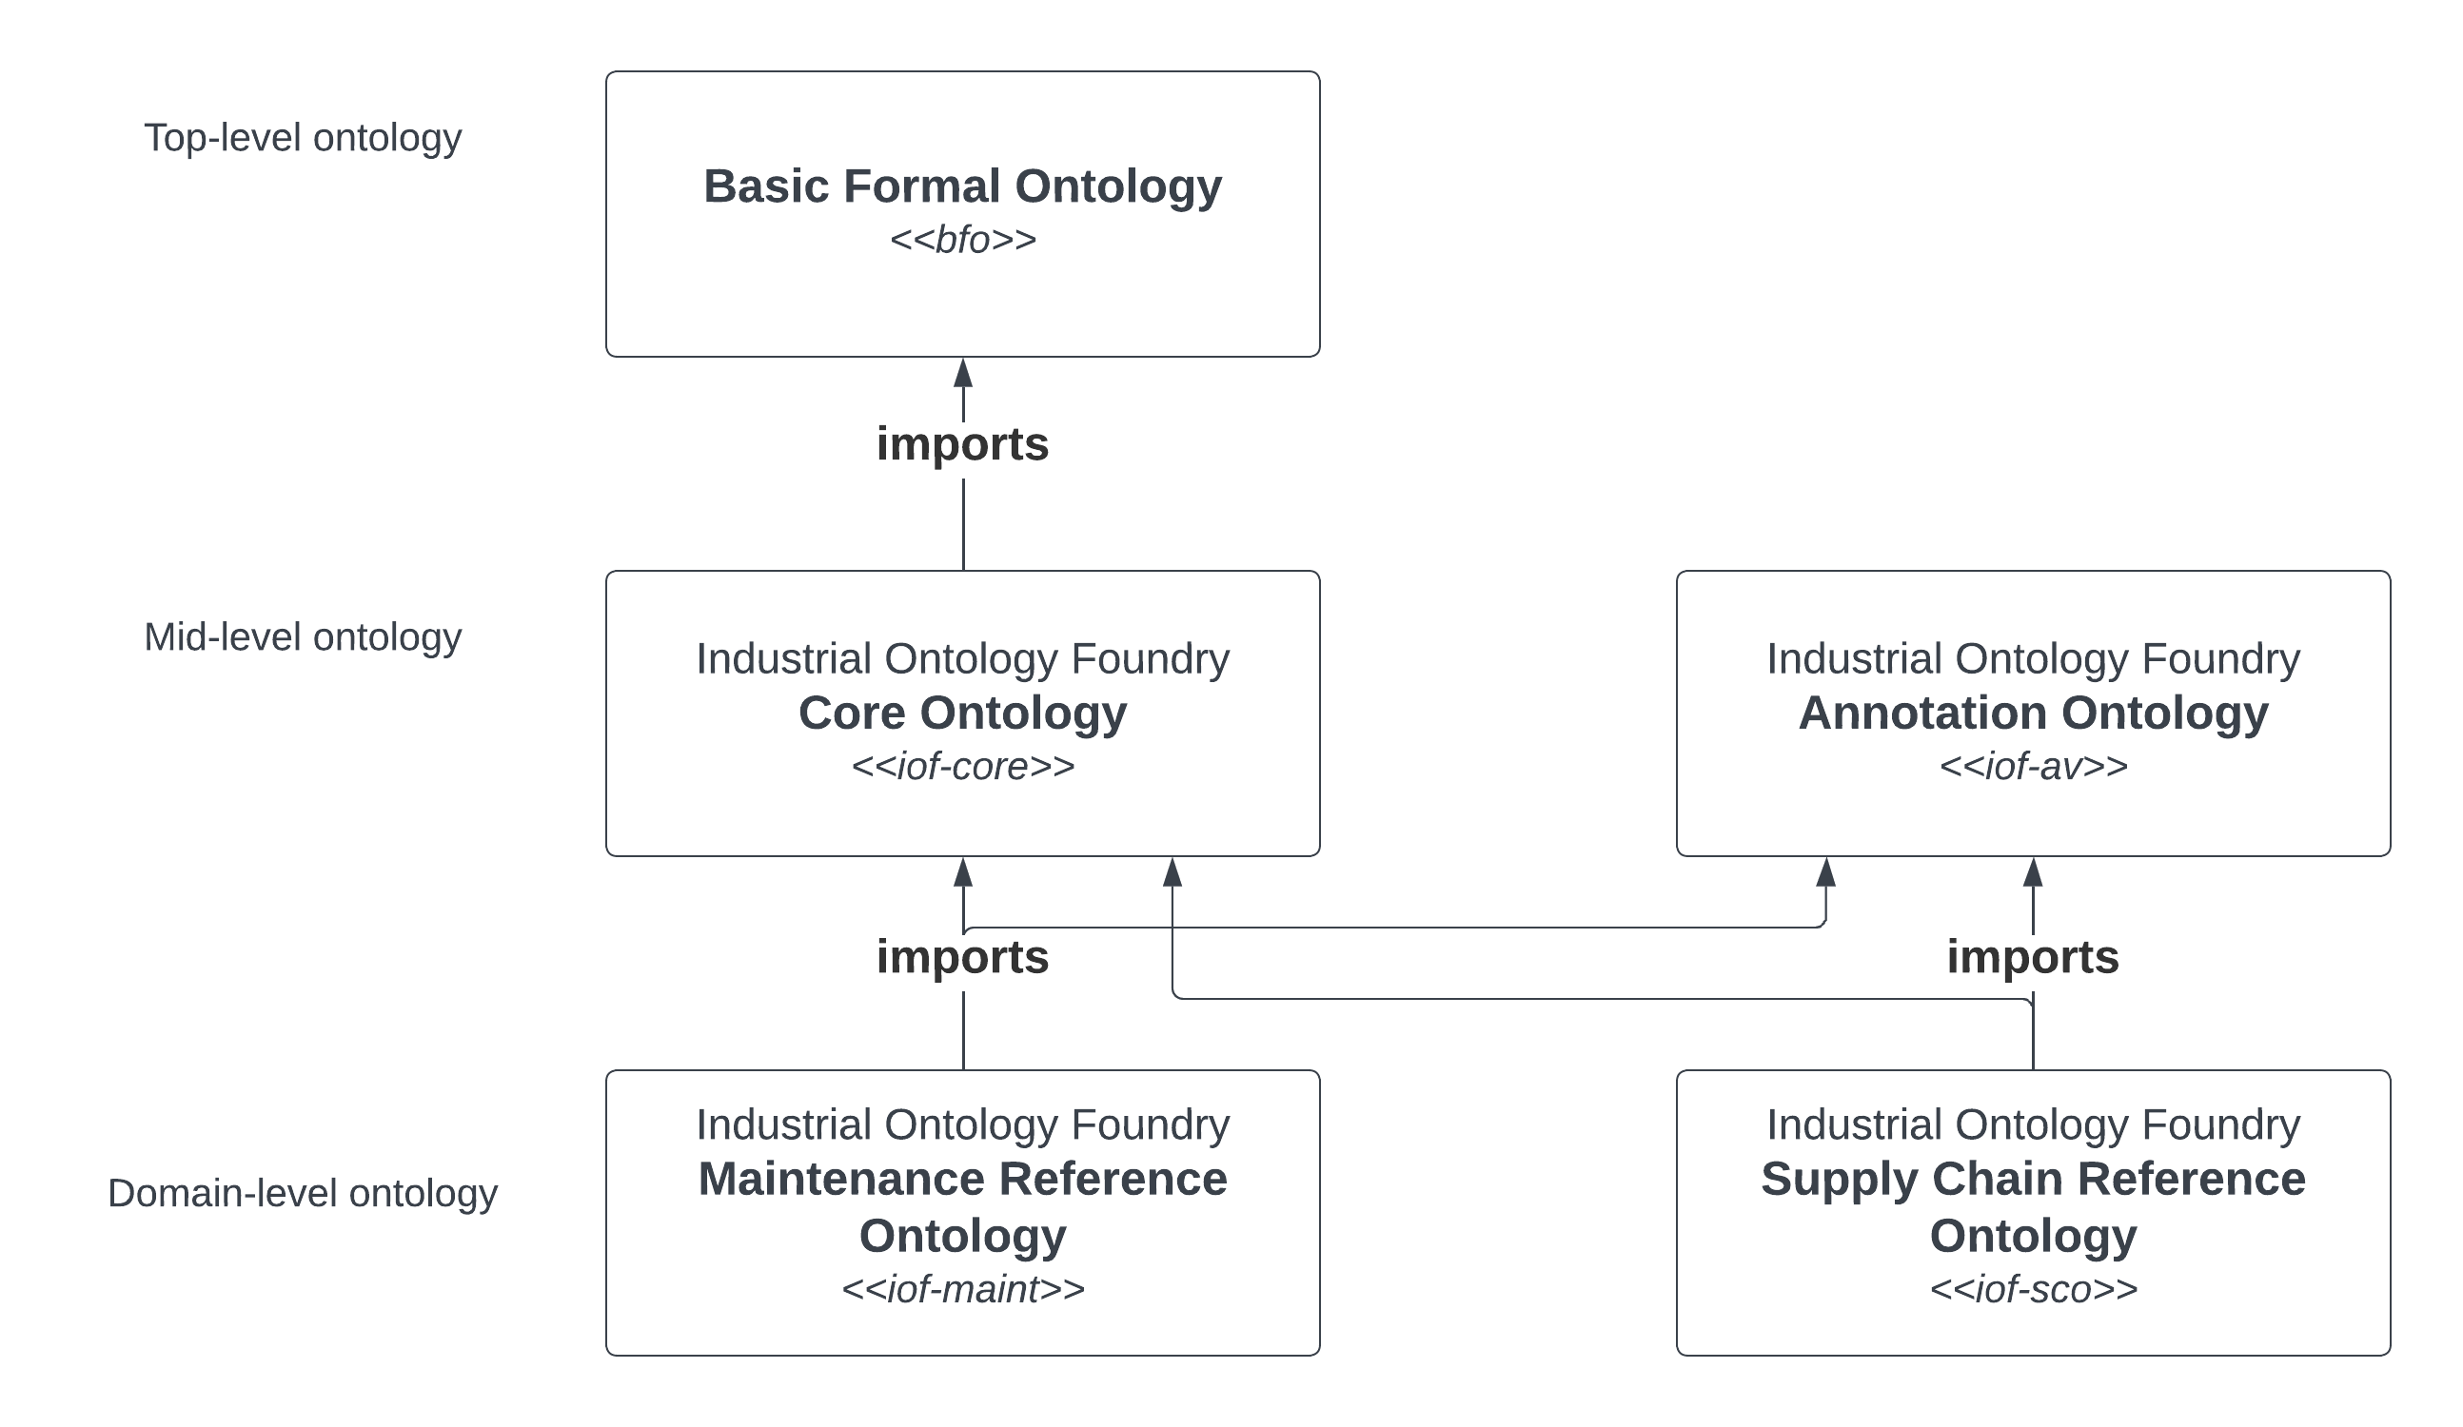
The IOF ontology family
4

Slide 13
Iof-maint ontology development approach
Iof-maint based on five use cases documented in peer-reviewed publications. See list on following slide
Each use case describes an application ontology and is supported by industrial data produced in the maintenance management process.
20 classes appearing in multiple use cases or are central to concepts in maintenance management are lifted to iof-maint as a common resource
Similarly, for object properties (2)
4

Slide 14
Application ontologies used in development of iof-maint
An ontology for maintenance activities and its application to data quality
https://content.iospress.com/articles/semantic-web/sw233299
An ontology for maintenance procedure documentation
https://content.iospress.com/articles/applied-ontology/ao230279
An ontology for failure modes and effects analysis
Hodkiewicz et.al. 2021. Computers in Industry
On the notion of maintenance state for industrial assets
Woods et.al. 2021. FOMI@JOWO 2021.
Towards a reference ontology for maintenance work management
https://ceur-ws.org/Vol-2900/WS5Paper2.pdf
4

Slide 15
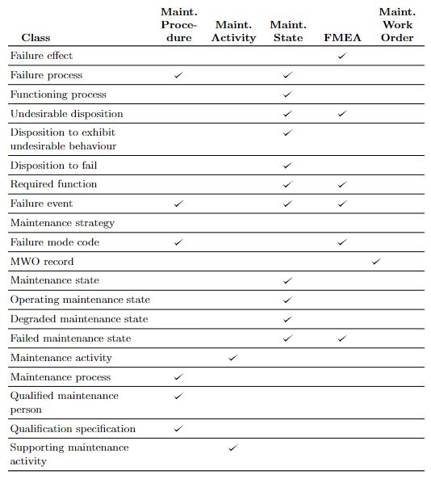
Lifting common terms
4

Slide 16
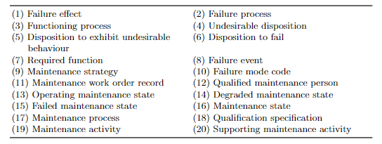
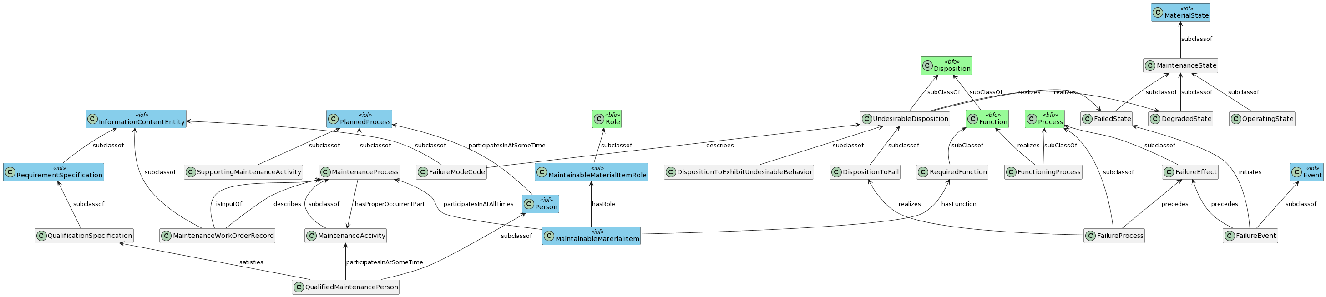
IOF maintenance reference ontology ido-maint:
https://spec.industrialontologies.org/iof/ontology/maintenance/MaintenanceReferenceOntology/
4
1. Also placed two maintenance relevant iof-core entities (MaintainableMaterialItem and MaintainableMaterialItemRole) directly under IOF Core

Slide 17
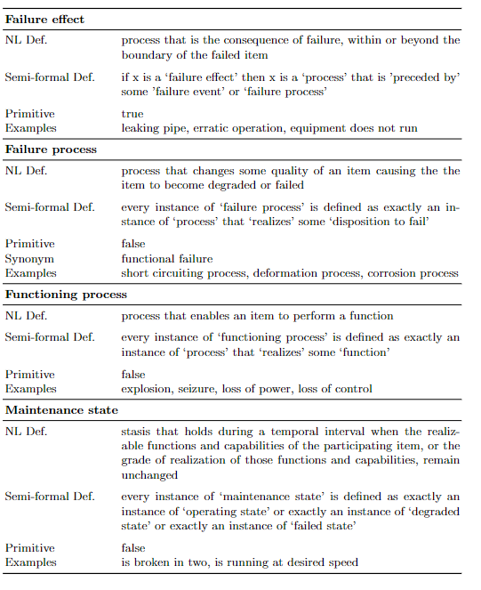
Example documentation of iof-maint
All terms and their documentation are at
https://spec.industrialontologies.org/iof/ontology/maintenance/MaintenanceReferenceOntology/
4

Slide 18
Any questions?
4

Slide 19
Part 2
Maintenance activity ontology
1

Slide 20
Workshop – use case
We will use the maintenance activity ontology and show how it can be used for monitoring the reliability of a pump.
This could be e.g a lubrication or cooling water pump on some piece of manufacturing equipment used in producing the engine or for a jet engine oil system.
A link to the GitHub is https://github.com/nlp-tlp/iof-maintenance-class/blob/main/README.md
To the Google Colab is https://colab.research.google.com/drive/1gVgtC-JcXikNPzpp8p1wIGstF0EEnwBl
A copy of the paper is available
https://content.iospress.com/download/semantic-web/sw233299?id=semantic-web%2Fsw233299
4

Slide 21
Maintenance activity ontology
Maintenance of assets is a multi-million dollar cost each year for asset intensive organisations in the defence, manufacturing, resource and infrastructure sectors. These costs are tracked though maintenance work order (MWO) records. MWO records contain structured data for dates, costs, and asset identification and unstructured text describing the work required, for example `replace leaking pump'. Our focus in this paper is on data quality for maintenance activity terms in MWO records (e.g. replace, repair, adjust and inspect).
We use natural language processing to identify seven core maintenance activity terms and their synonyms from 800,000 MWOs. We provide elucidations for these seven terms. We demonstrate use of the reference ontology in an application-level ontology using an industrial use case. The end-to-end NLP-ontology pipeline identifies data quality issues with 55% of the MWO records for a centrifugal pump over 8 years. For the 33% of records where a verb was not provided in the unstructured text, the ontology can infer a relevant activity class.
A link to the GitHub file is:
https://github.com/uwasystemhealth/Paper_Archive_Maintenance_Activity
4

Slide 22
Any questions?
4

Slide 23
Part 3
Information extraction from unstructured text and the role of ontologies in this process
1

Slide 24
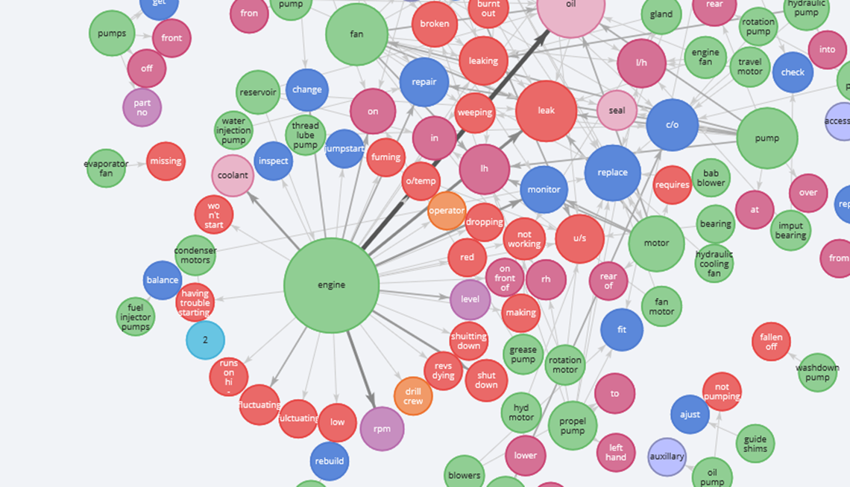

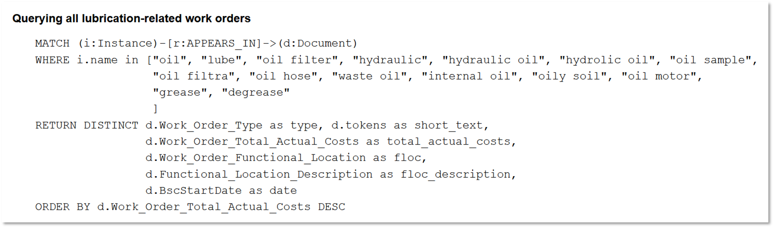

UWA NLP-TLP information (entity) extraction pipeline
`(replace)[Activity]-[hasParticipant]->(valve)[PhysicalObject]`
`(change out)[Activity]-[hasParticipant]->(gaskets)[PhysicalObject]`
`(compressor)[PhysicalObject]-[hasPart] -> (valve)[PhysicalObject]`
Replace compressor valve and changeout gasket
Input technical texts
Form semantic triples
MWO2KG and Echidna: Constructing and exploring knowledge graphs from maintenance data https://journals.sagepub.com/doi/full/10.1177/1748006X221131128
Knowledge Graph Query
Create Knowledge Graph

Slide 25
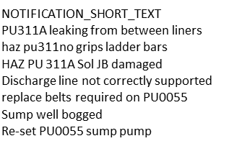
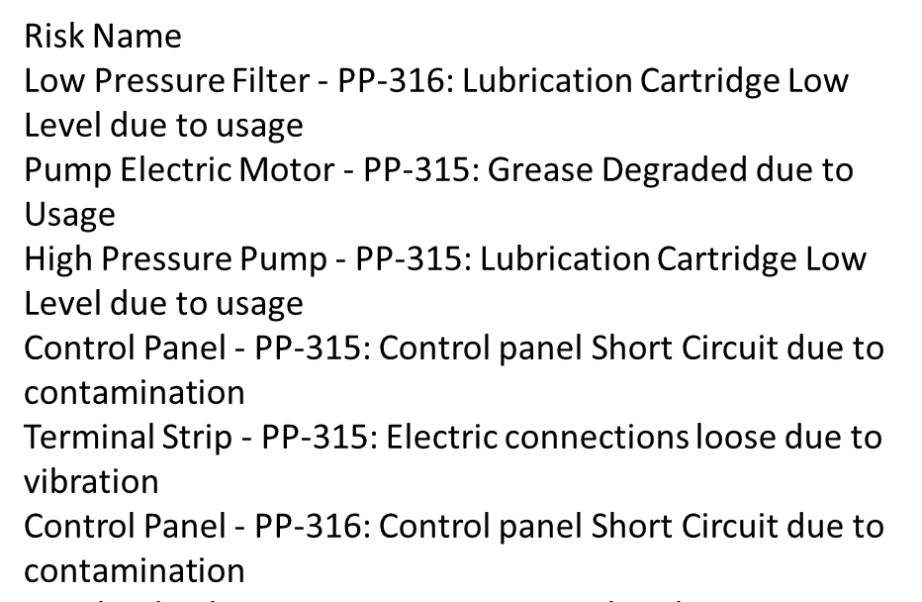
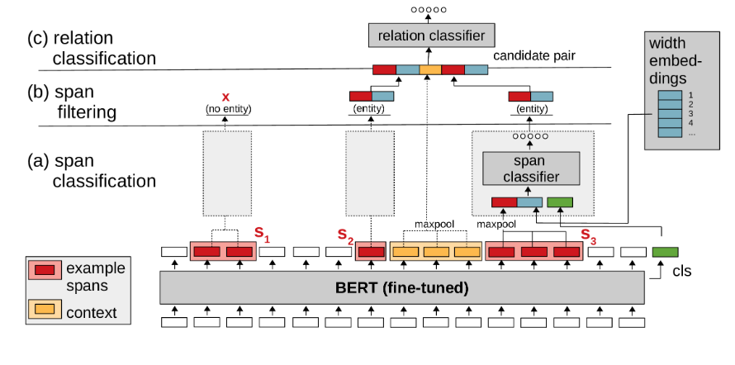
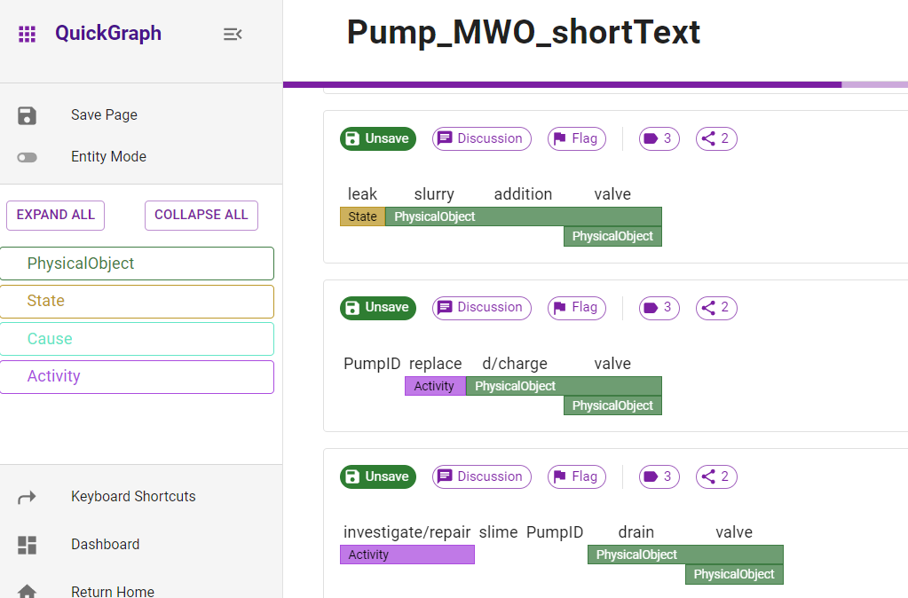
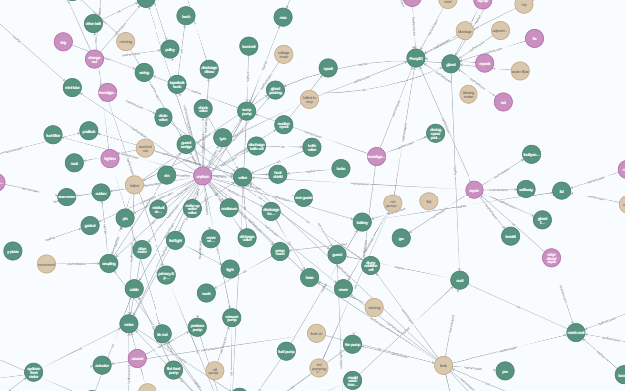
MWO and FMEA (entity and relation) to KG pipeline
MaintIE – annotated MWO corpus
Uses all openly available tools. See end slide for links
105,100 MWOs
103,000 FMEA’s
Sample & Pre-process
(~500 from each data set)
Connect annotated
KG – 105,100 MWOs +
KG – 103,000
FMEAs in KG
SPERT transformer
Industry expert annotation
Fine-tuned maintenance-language model
Query on Neo4J Knowledge Graph (KG)
Additional annotation to improve model performance
Puggle
Company annotated corpus
Gold annotated strategy test set
Annotation model performance

Slide 26
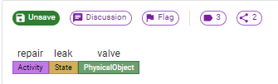
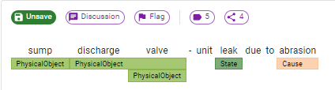
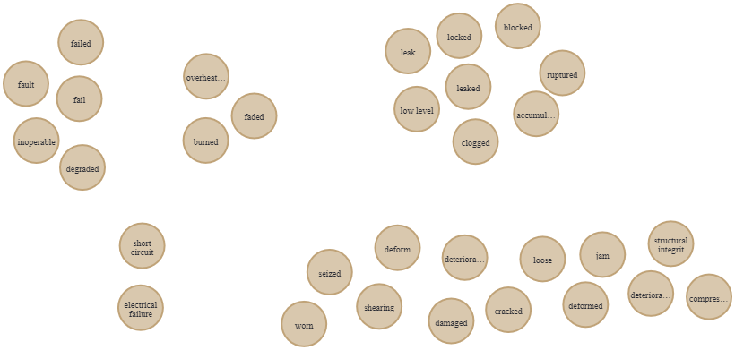
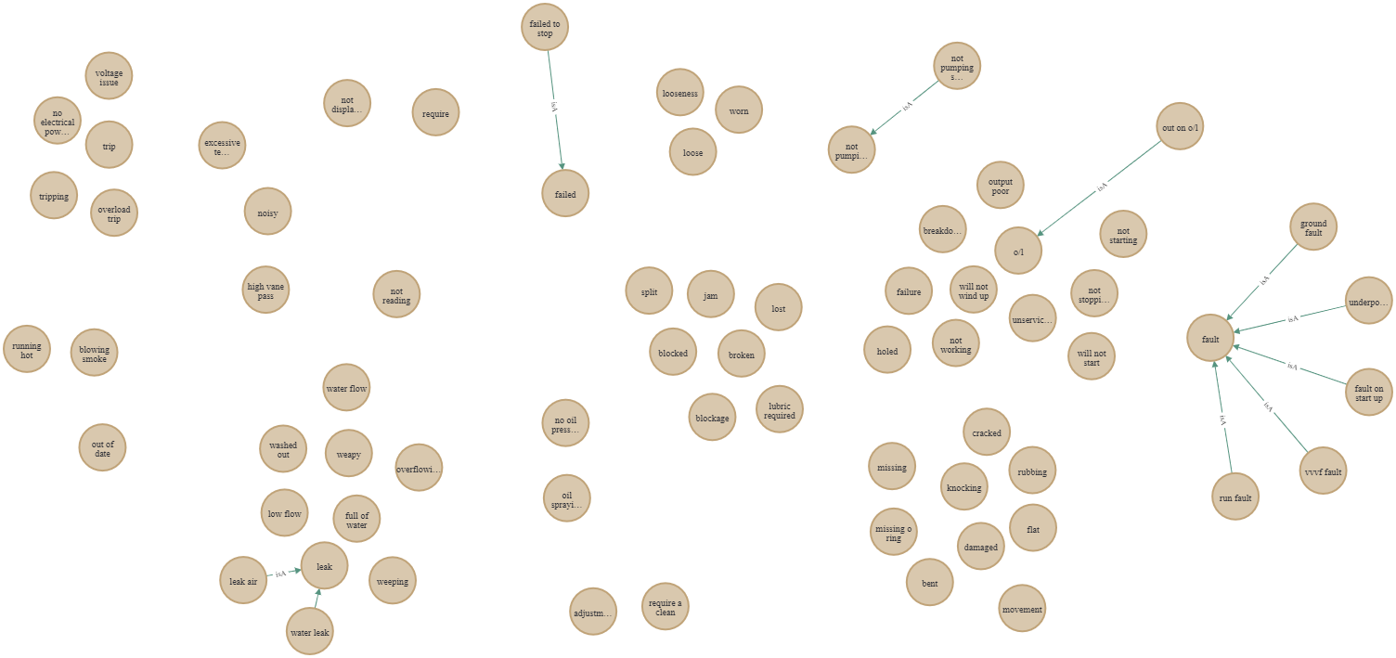
Automatically identify ‘state of equipment’ from texts
FMEA
MWO
Ability to check if a state anticipated in strategy is realised in a MWO event
Identify how states are described in FMEAs
Identify how states are described in MWOs

Slide 27
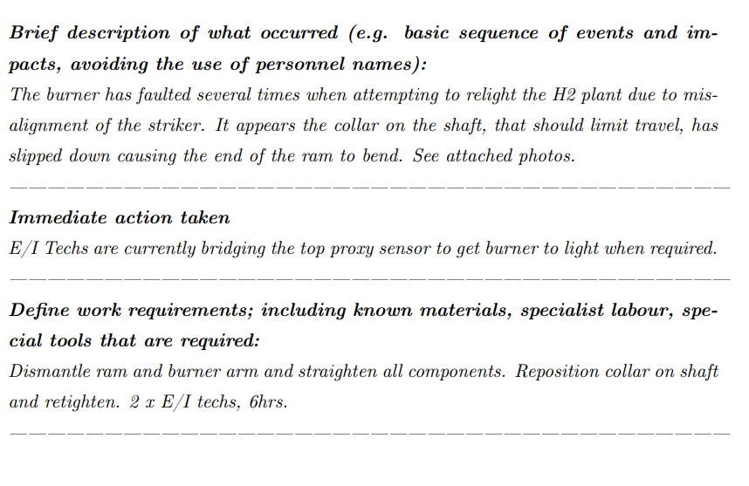
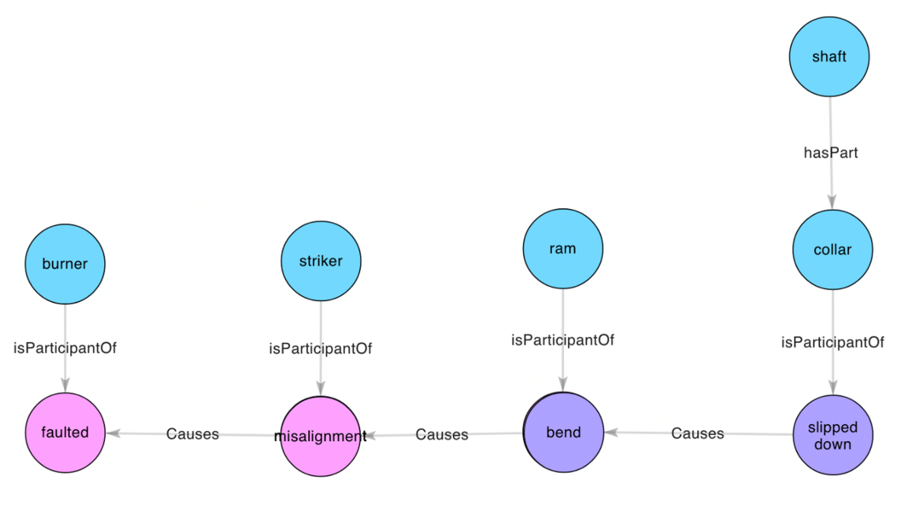
Automatically produce causal failure analysis
Use of ‘entity and relations’ information extraction pipeline to automatically extract structured causal information from long text maintenance records to answer:
What are the most frequent, or most costly, or most recent CAUSES of centrifugal pump failures at my facility (from 98,000 notifications)
12

Slide 28
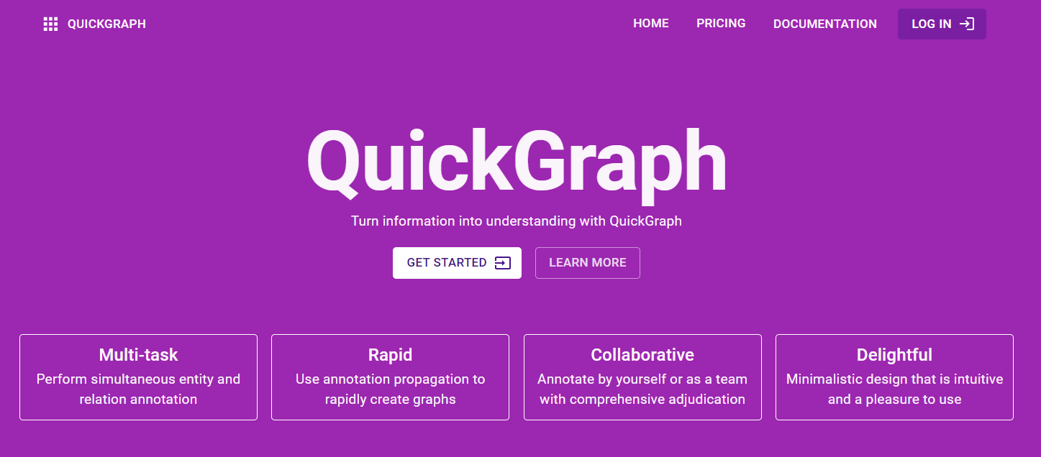
Annotation of text records is vital for information extractionnnotation output
We use Quickgraph.
A tool we have developed at UWA.
Quickgraph is free to use.
Quickgraph does entity only and entity and relations annotation
It is designed for collaboration and includes inter-annotator agreement measures
Has excellent documentation
https://quickgraph.tech/

Slide 29
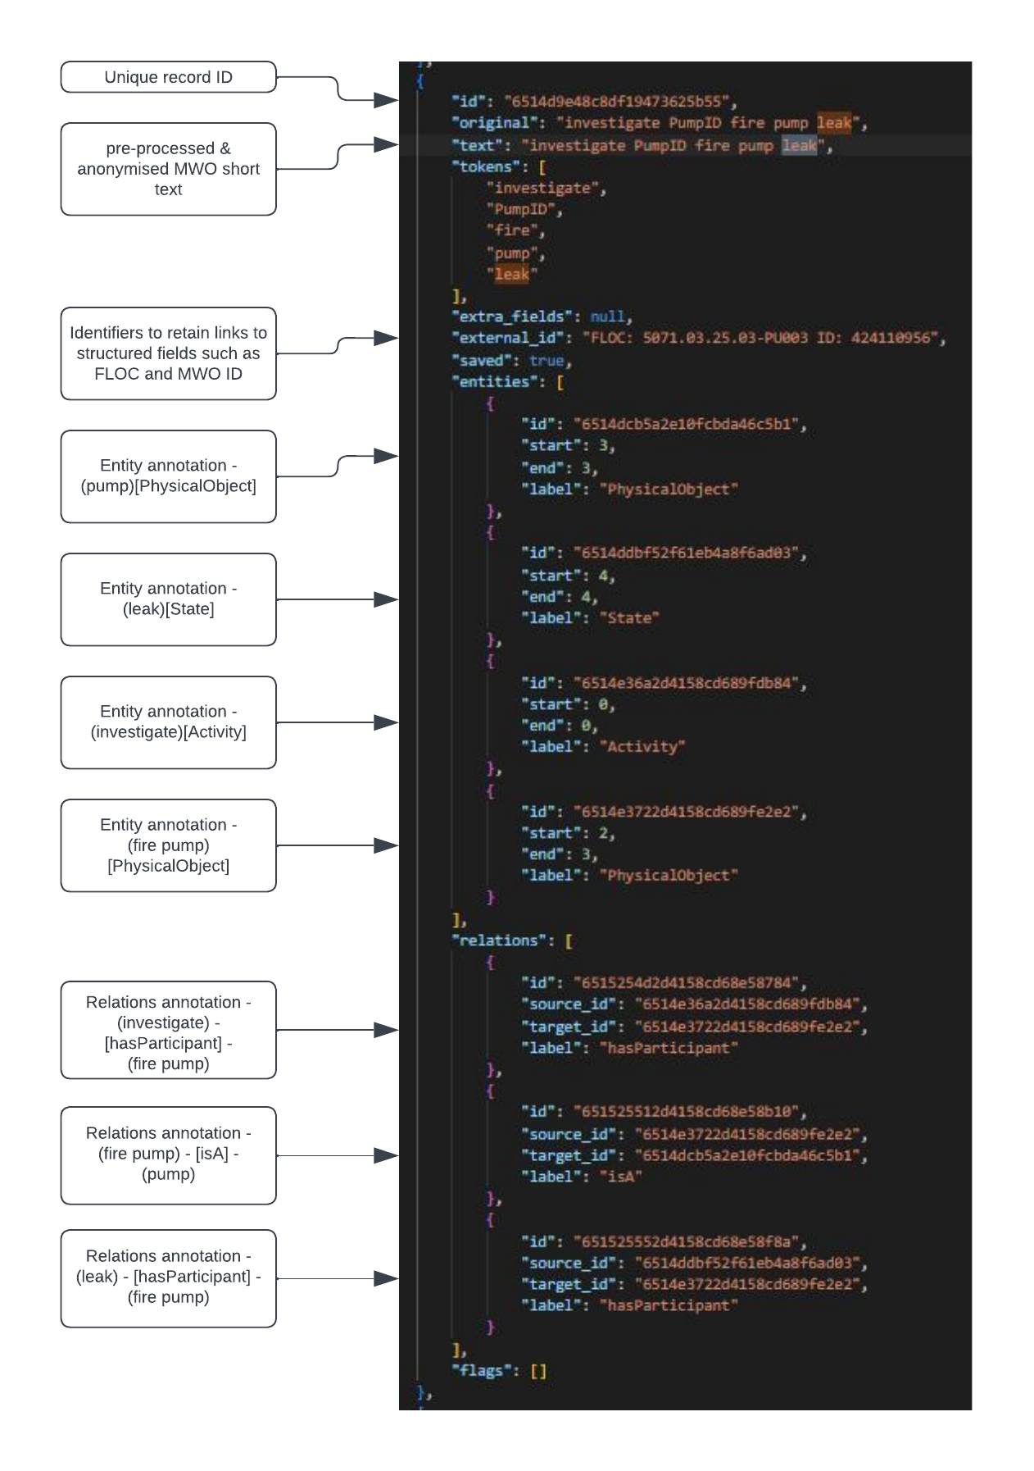
Example of QuickGraph json file annotation output
An example of one QuickGraph record showing coarse annotation schema for “investigate PumpID fire pump leak”
QuickGraph record includes field to link to other fields in the original record to enable ‘other data’ such as cost, date, etc to be imported into a KG
Records are seamlessly imported into Property Graph e.g. Neo4J for visualisation and query
Quickgraph is configurable to any annotation schema
Quickgraph uses distant supervision to improve annotation efficiency, handles multiple annotator and annotation agreement
https://quickgraph.tech/

Slide 30
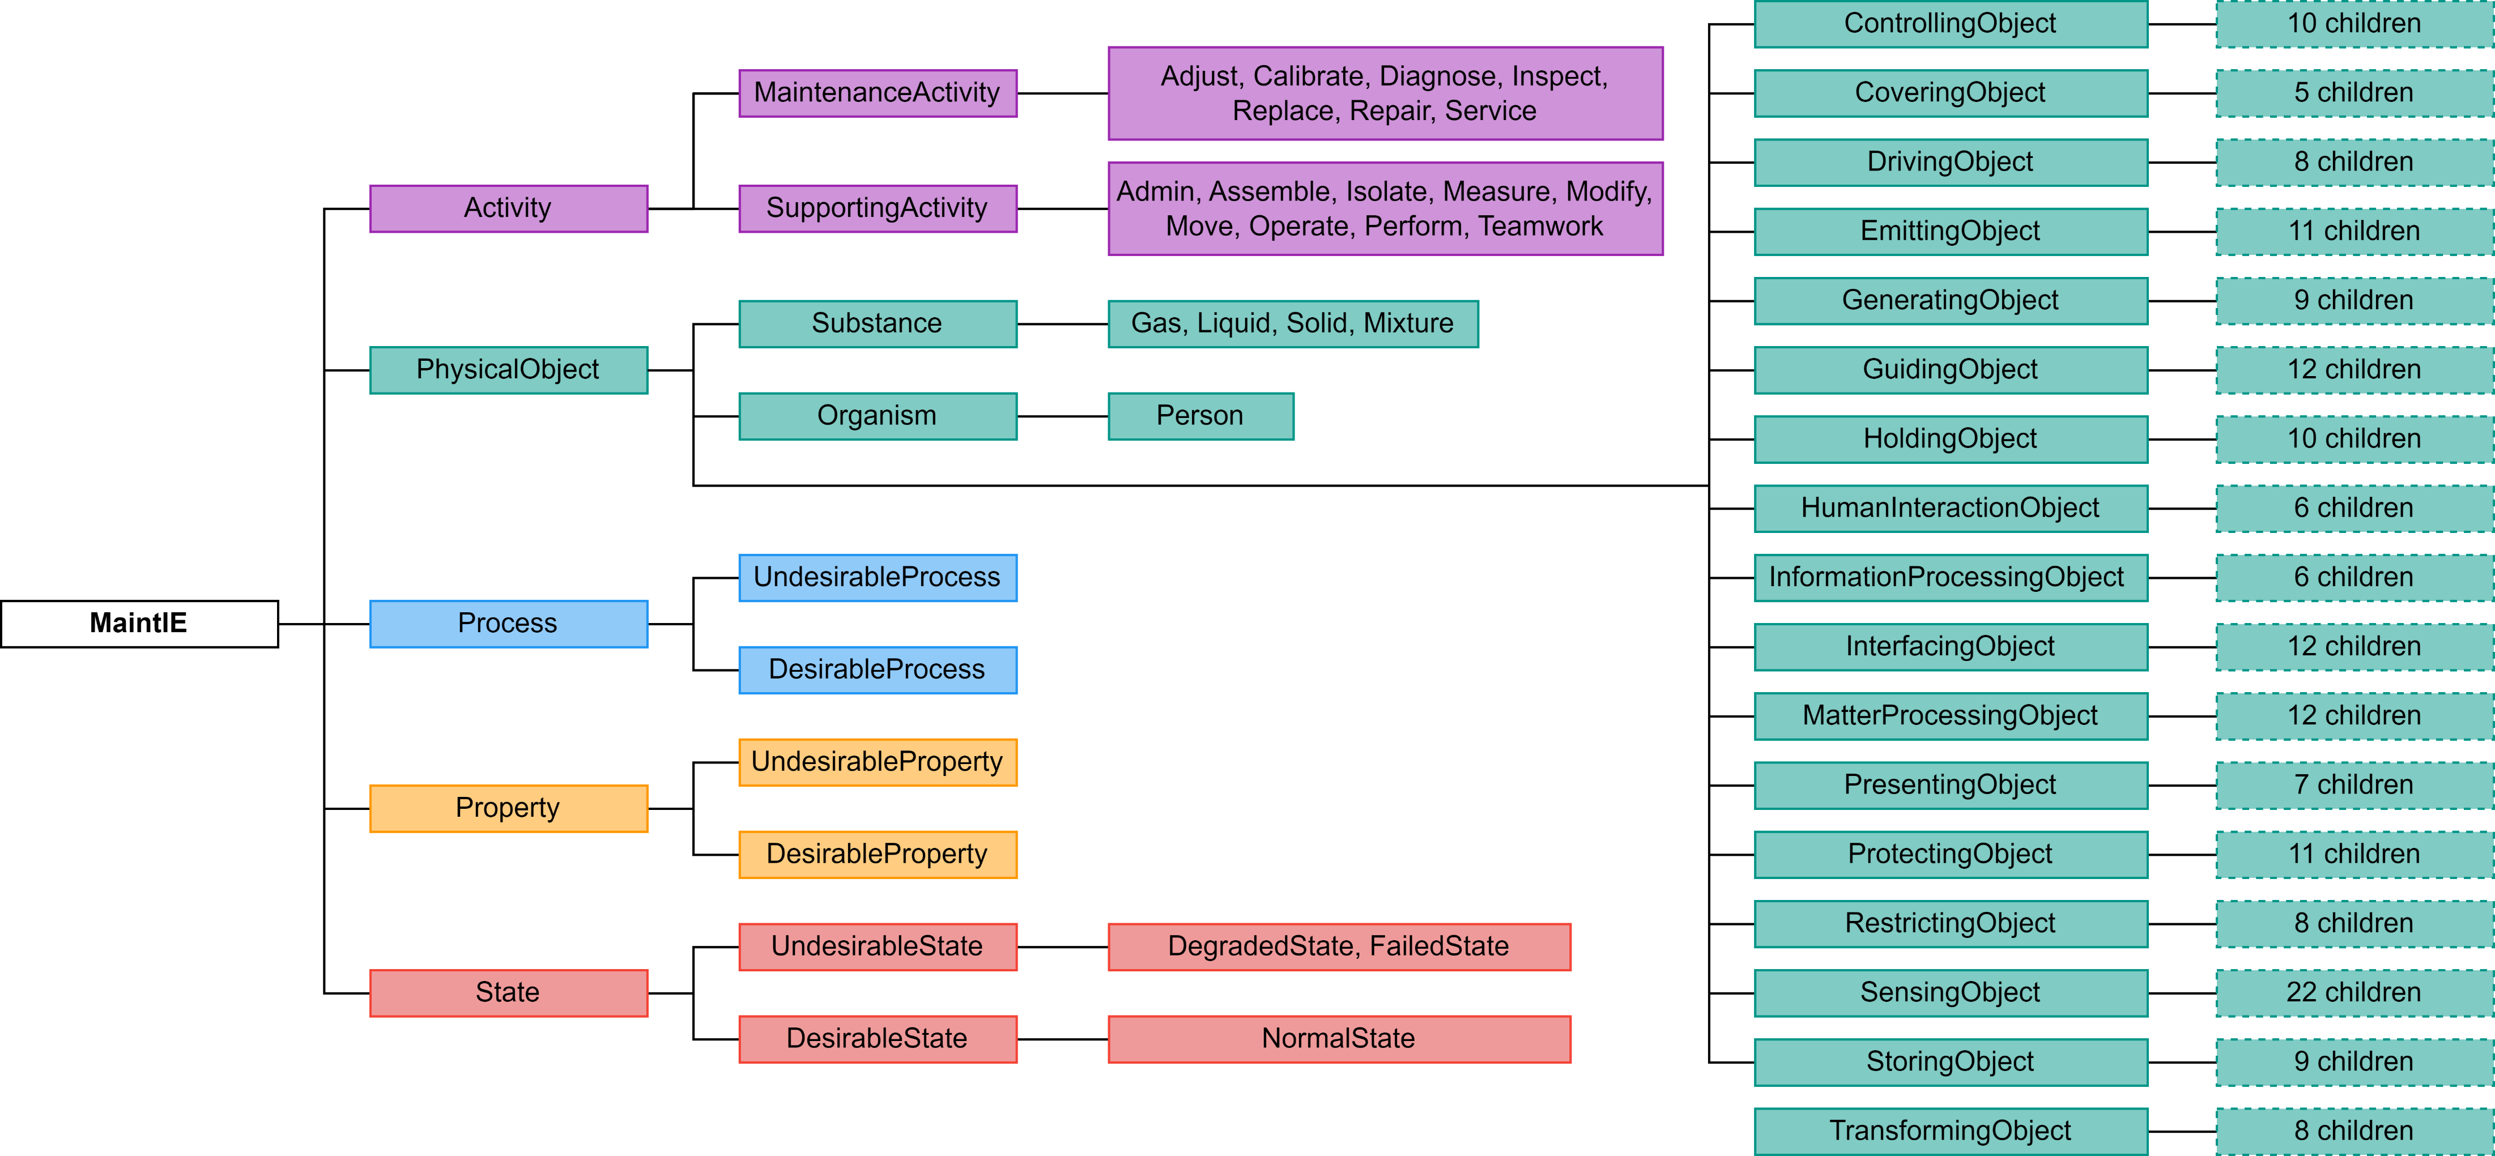
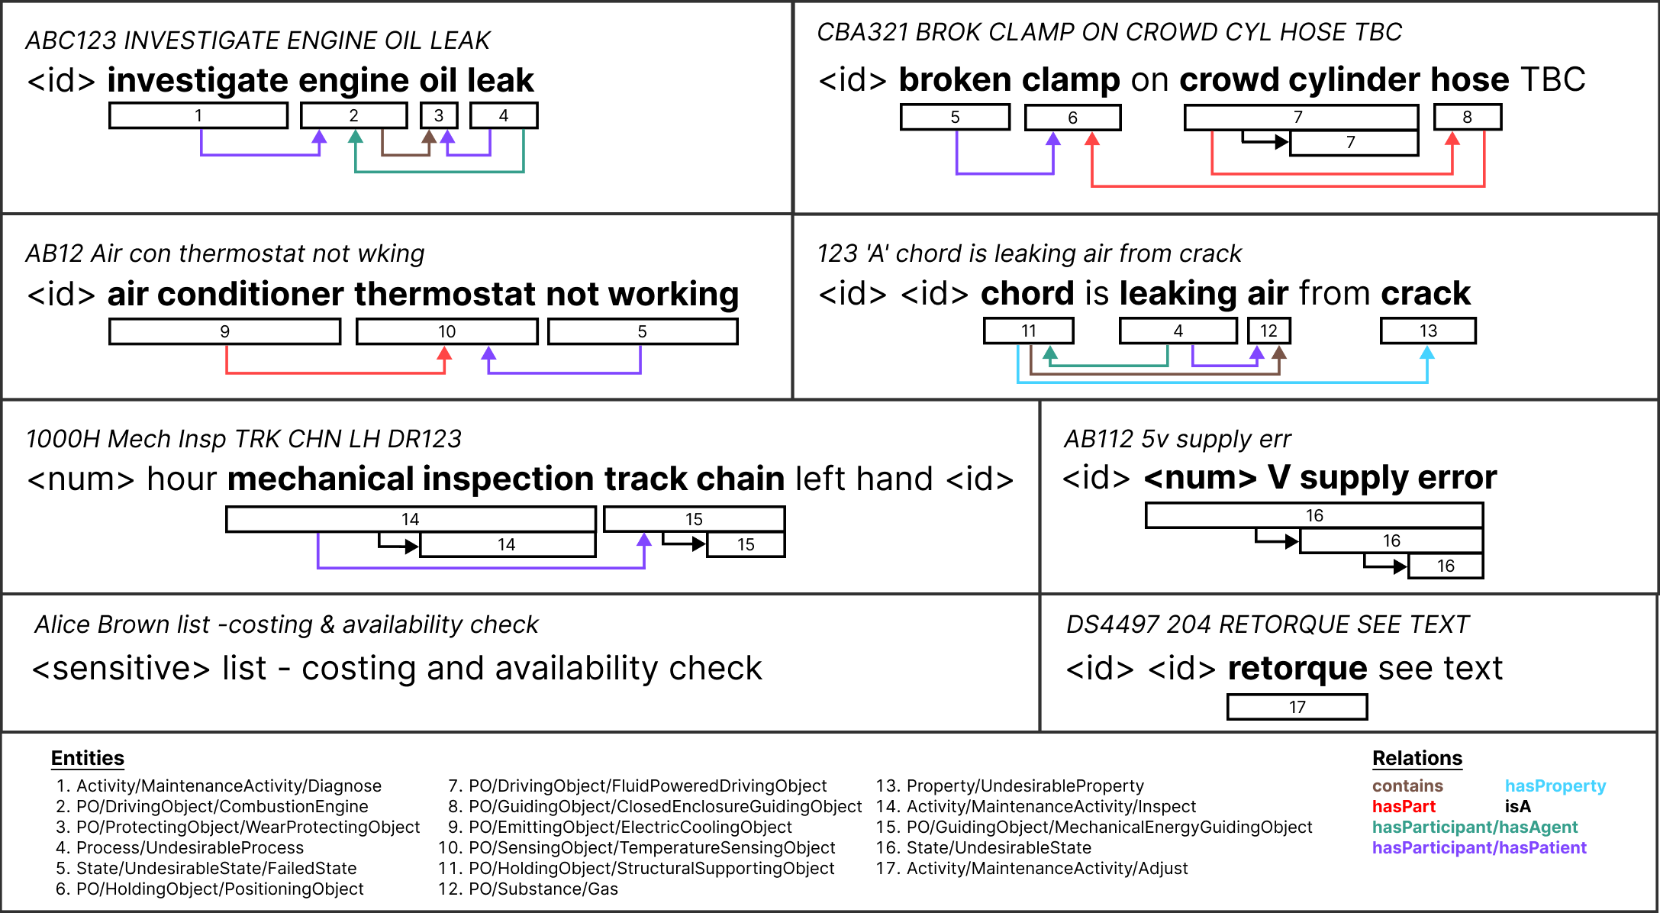
MaintIE corpus released Oct 2023 to bootstrap fine tuning of language models on maintenance texts
MaintIE: A Fine-Grained Annotation Schema and Benchmark for Information Extraction (entity AND relations) from Low-Quality Maintenance Short Texts https://github.com/nlp-tlp/maintie
Gold standard fine grained annotations (3400 E & 2340 R)
Silver annotated coarse grained (22,100 E + 15,200 R)
5 coarse-grained entity types
6 relations
224 fine grained entities (physical objects aligned to IEC 81346)
Corpus usable to fine-tuned (E&R) language models
(e.g. SPERT/REBEL) for downstream use to annotate MWO’s at scale and export annotations to a KG

Slide 31
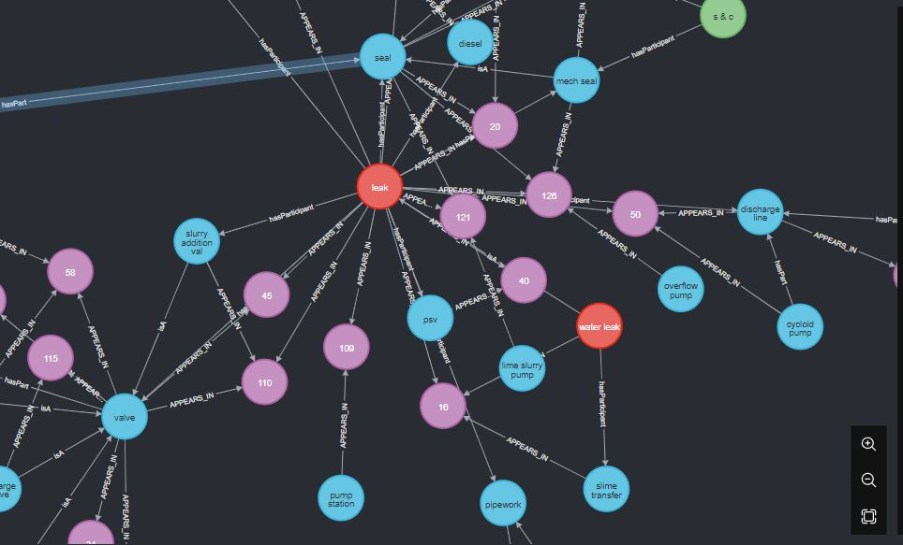
Insight into how your technicians/operators describe states
Ability to identify and count different types of failure events described in the unstructured short text data in MWO
"adjustment" | 1
"bent" | 1
"blockage" | 1
"blocked" | 4
"blowing smoke" | 1
"breakdown" | 1
"broken" | 1
"cracked" | 1
"damaged" | 1
"excessive mtr temperature" | 1
"failed" | 4
"failed to stop" | 1
"failure" | 1
"fault" | 11
"fault on start up" | 1
"flat" | 1
"full of water" | 1
"ground fault" | 1
"high vane pass" | 1
"holed" | 1
"jam" | 1
"knocking" | 1
"leak" | 14
"leak air" | 1
"loose" | 2
"looseness" | 1
"lost" | 1
"low flow" | 1
"lubric required" | 1
"missing" | 2
"missing o ring" | 1
"movement" | 1
"no electrical power" | 1
"no oil pressure" | 1
"noisy" | 2
"not displaying" | 1
"not pumping" | 4
"not pumping to spec" | 1
"not reading" | 1
"not starting" | 1
"not stopping" | 1
"not working" | 1
"o/l" | 1
"oil spraying" | 1
"out of date" | 1
"out on o/l" | 1
"output poor" | 1
"overflowing" | 1
"overload trip" | 1
"require" | 1
"require a clean" | 1
"rubbing" | 1
"run fault" | 1
"running hot" | 1
"split" | 1
"trip" | 1
"tripping" | 1
"underpower fault" | 1
"unserviceable" | 5
"voltage issue" | 1
"vvvf fault" | 1
"washed out" | 1
"water flow" | 1
"water leak" | 1
"weapy" | 1
"weeping" | 1
"will not start" | 1
"will not wind up" | 1
"worn" | 2
This analysis can be scaled over thousands of MWOs.
Classification classes can be improved with post-processing

Slide 32
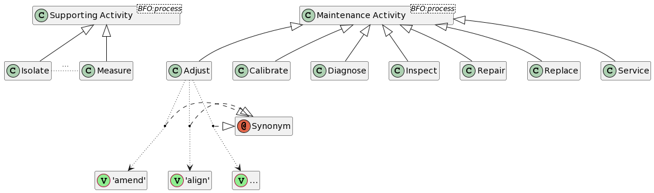
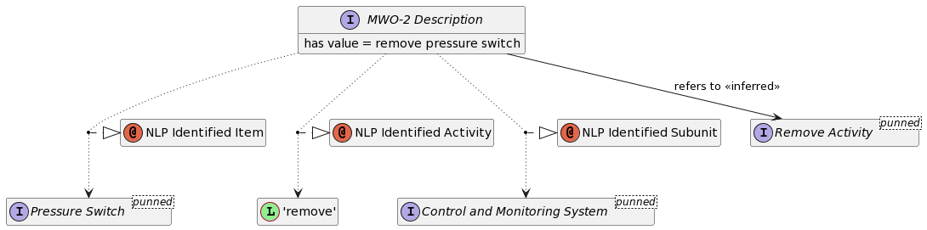
Ontology for Maintenance work order ‘Activity’ quality control
We use natural language processing to identify seven core maintenance activity terms and their synonyms from 800,000 MWOs.
We provide elucidations for these seven terms.
The end-to-end NLP-ontology pipeline identifies data quality issues with 55% of the MWO records for a centrifugal pump over 8 years.
For the 33% of records where a verb was not provided in the unstructured text, the ontology can infer a relevant activity class.
Woods, C., Selway, M., Bikaun, T., Stumptner, M. and Hodkiewicz, M., An ontology for maintenance activities and its application to data quality. Semantic Web, (Preprint), pp.1-34.
https://content.iospress.com/articles/semantic-web/sw233299

Slide 33

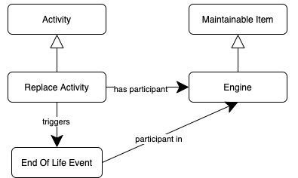

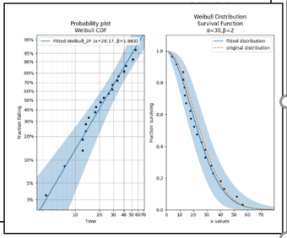
An ontology for ensuring data quality - RelOps pipeline
1. Raw Work Order
3. Populated ontology
Replace engine EN001
ontology population
Named entity recognition and transfer learning to tag at scale
reasoning
4. Inferred Knowledge
2. Tagged Work Order
Engine EN001 participated in an end-of-life event.
Note: this information can be used to validate a maintenance strategy and calculate MTBF (and make use of inheritance)
Replace engine EN001
Activity
Item
Identifier
Hodkiewicz, M., Bikaun, T. and Stewart, M., 2023. RelOps–A Whole-of-Organisation Approach for Reliability Analytics. In 16th WCEAM Proceedings (pp. 45-55). Cham: Springer International Publishing. https://link.springer.com/chapter/10.1007/978-3-031-25448-2_5

Slide 34
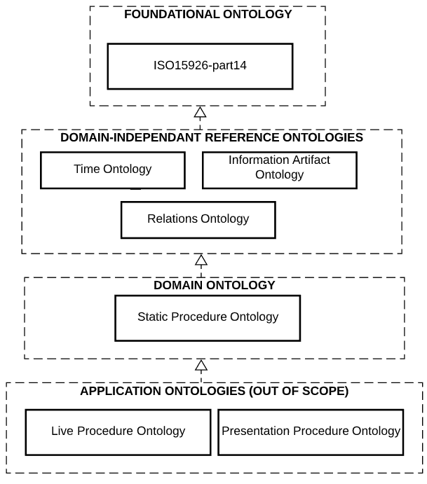
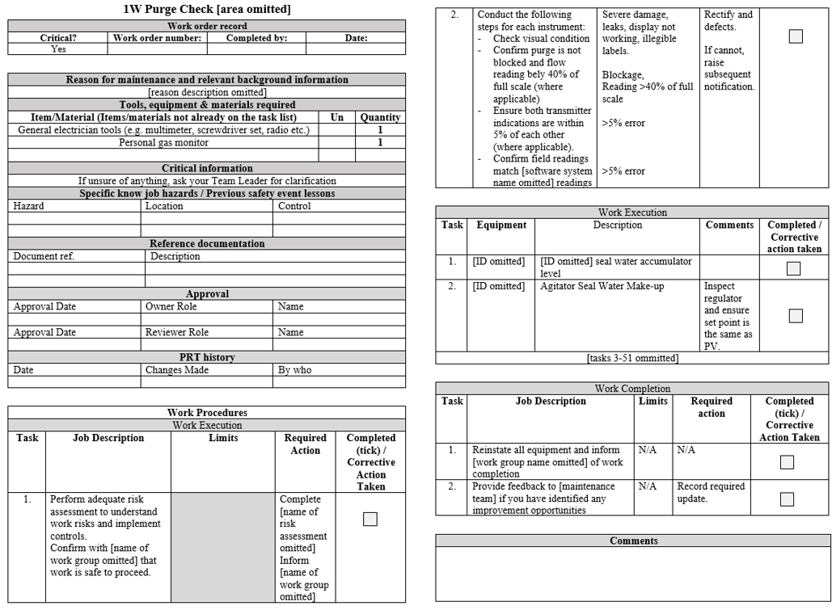
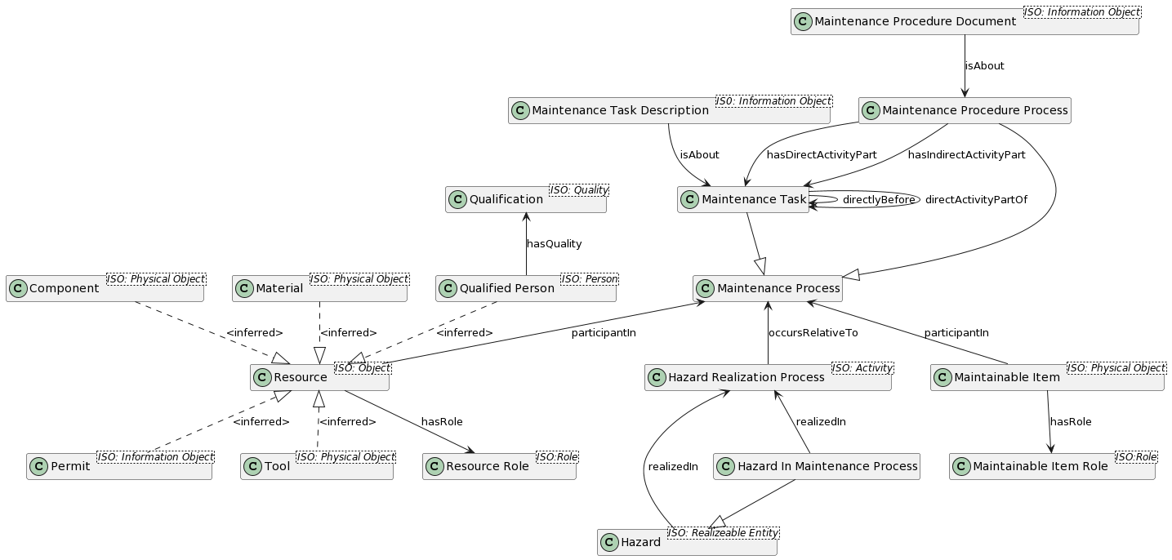
IDO-based Ontology for Maintenance Procedure documentation and reasoning
Competency questions requiring reasoning
What tools, materials and permits do I require to execute a procedure?
What steps need to be performed to execute my procedure
Given that I am up to task x in a procedure, what task needs to be performed next?
Does my procedure have any safety hazards that I need to be aware of?
Woods, C., French, T., Hodkiewicz, M. and Bikaun, T., 2023. An ontology for maintenance procedure documentation. Applied Ontology, pp.1-38. https://content.iospress.com/articles/applied-ontology/ao230279
Notes:
Query information held in real industrial maintenance procedures.
We develop an ontology for maintenance procedures using the OWL 2 description language.
Use ISO 15926 Part 14 Upper Ontology and create a domain ontology

Slide 35
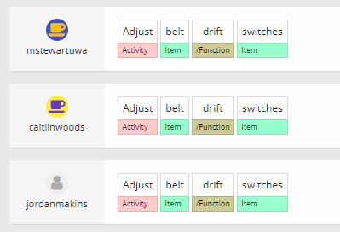
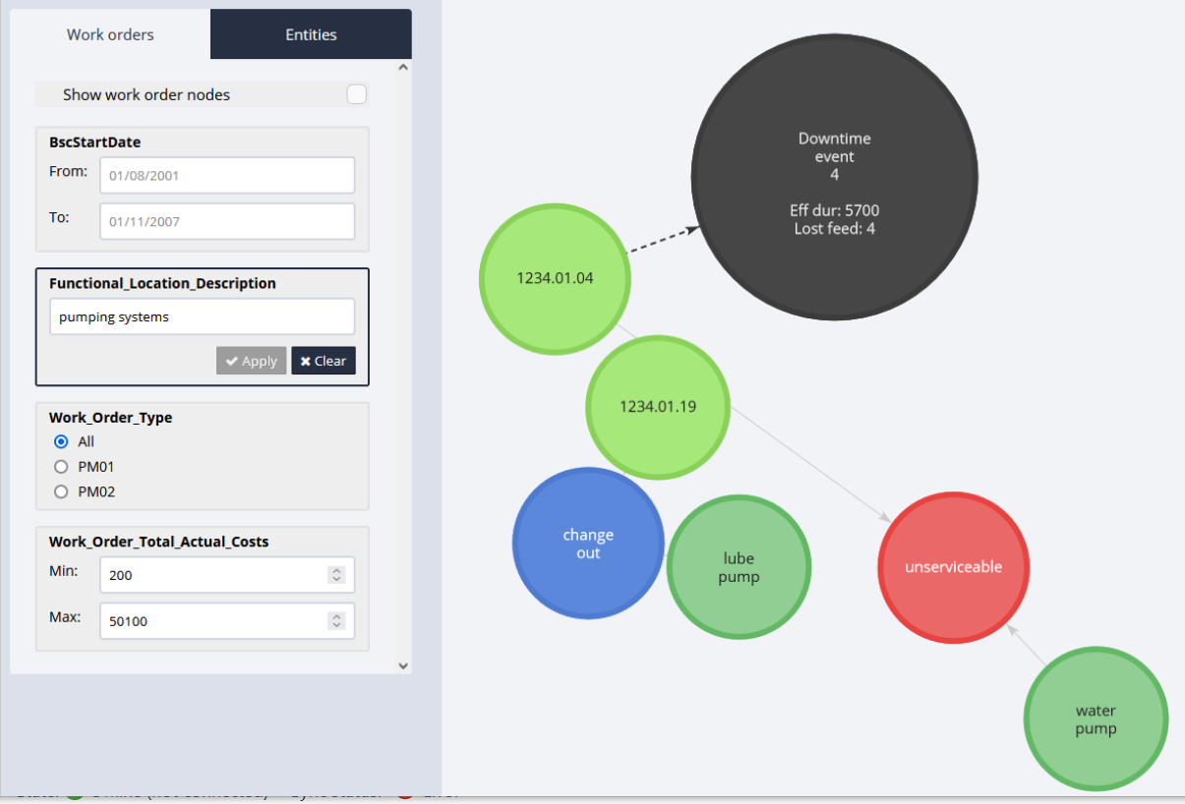
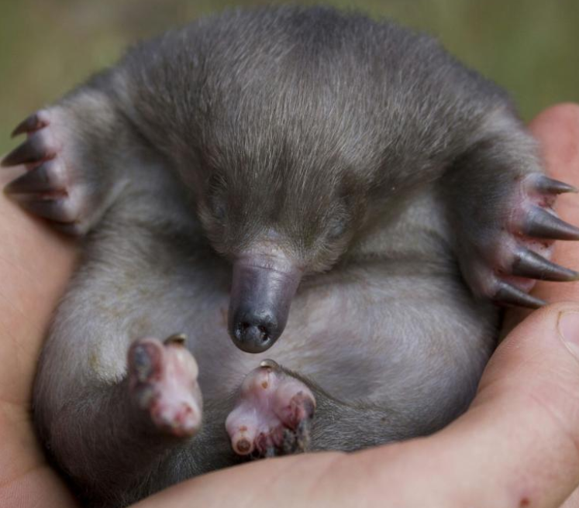
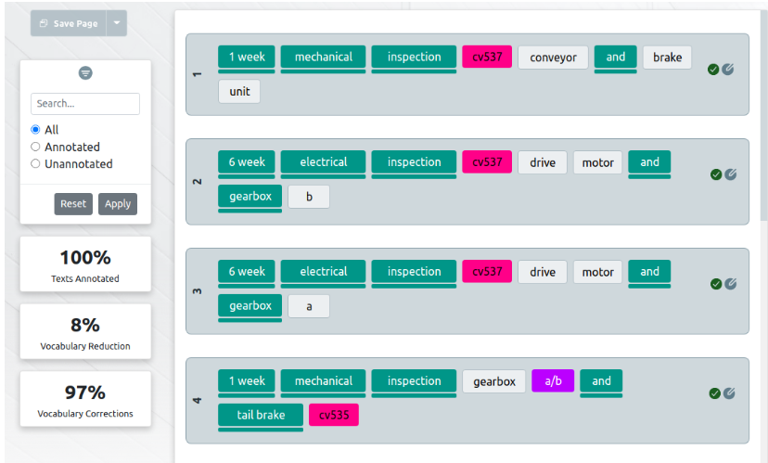
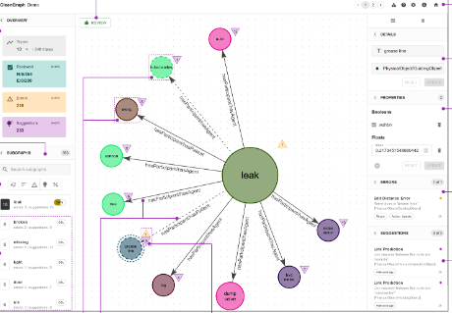
Examples of our open (NLP-TLP) tools
Open access Tools developed by the UWA NLP-TLP group
QuickGraph
Entity and relation annotation for KG extraction
https://quickgraph.tech/
Redcoat
Collaborative annotation for MWOS
nlp-tlp.org/redcoat
Echidna
Knowledge graph user-friendly interrogation
nlp-tlp.org/maintenance_kg
PUGGLE
NER&R.Json to KG conversion python package
https://pypi.org/project/puggle/
Lexiclean
Lexical normalisation noisy corpora
https://github.com/nlp-tlp/lexiclean
CleanGraph
Error correction in KGs
https://github.com/nlp-tlp/CleanGraph

Slide 36
References and links
MaintIE: Data set and schema at https://github.com/nlp-tlp/maintie
QuickGraph: https://quickgraph.tech/
IOF-maint: https://spec.industrialontologies.org/iof/ontology/maintenance/Metadatamaintenance/maintenanceModule
FMEA: Hodkiewicz, M., Klüwer, J.W., Woods, C., Smoker, T. and Low, E., 2021. An ontology for reasoning over engineering textual data stored in FMEA spreadsheet tables. Computers in Industry, 131, p.103496. https://github.com/uwasystemhealth/Paper_Archive_CII_FMEA_Ontology
Procedure: Woods, C., French, T., Hodkiewicz, M. and Bikaun, T., 2023. An ontology for maintenance procedure documentation. Applied Ontology, (Preprint), pp.1-38.
Tables: Wu, H., French, T., Liu, W. and Hodkiewicz, M., 2022. Automatic semantic knowledge extraction from electronic forms. Proceedings of the Institution of Mechanical Engineers, Part O: Journal of Risk and Reliability https://doi.org/10.1177/1748006X221098.
Activity: Woods, C., Selway, M., Bikaun, T., Stumptner, M. and Hodkiewicz, M., 2023 An ontology for maintenance activities and its application to data quality. Semantic Web, (Preprint), pp.1-34. https://github.com/uwasystemhealth/Paper_Archive_Maintenance_Activity
MTBF: Bikaun, T. and Hodkiewicz, M., 2021, June. Semi-automated Estimation of Reliability Measures from Maintenance Work Order Records. In PHM Society European Conference (Vol. 6, No. 1, pp. 9-9).
ROMAIN: Karray, M.H., Ameri, F., Hodkiewicz, M. and Louge, T., 2019. ROMAIN: Towards a BFO compliant reference ontology for industrial maintenance. Applied Ontology, 14(2), pp.155-177. https://github.com/uwasystemhealth/ROMAIN_maintenance_ontology
State: Woods, C., Selway, M., Hodkiewicz, M., Ameri, F., Stumptner, M. and Sobel, W., 2021. On the Notion of Maintenance State for Industrial Assets. In JOWO.
4

Slide 37
Any questions?
4

Slide 38
Thank you
For list of papers please see https://nlp-tlp.org/ and on Google Scholar
For Code https://github.com/nlp-tlp, https://github.com/uwasystemhealth, https://github.com/mhodki
For Models https://huggingface.co/nlp-tlp
Information on Centre for Transforming Maintenance through Data Science (CTMTDS) https://www.maintenance.org.au/
Contact details Melinda.Hodkiewicz@uwa.edu.au and https://www.linkedin.com/in/melinda-hodkiewicz-b6bbba7/
This work impossible for me to do without Wei Liu, Tim French, Caitlin Woods, Tyler Bikaun, Michael Stewart, IDO team and many others.
20

